Slide 1
CS 3451: Computer Graphics
Blair MacIntyre
Fall 2019

Slide 2

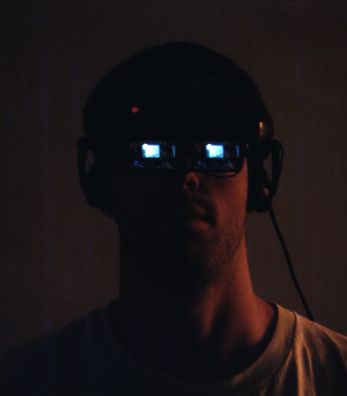
Introductions
Instructor
Blair MacIntyre
blair@cc.gatech.edu
Augmented and Mixed Reality (“interactive 3D in the world”), Games, Graphics, HCI
Professor, Coc/IC; Adjunt Professor, LMC
Principal Research Scientist, Mozilla
Design of MR/AR experiences (3D in the world), web-based XR
Background in math, CS, 3D graphics
PhD research in distributed interactive 3D software design

Slide 4
TAs
Elie Diaz (ediaz30@gatech.edu)
Evan Goode (egoode6@gatech.edu)
Ryan He (zhe66@gatech.edu)
Daniel Kane (dkane6@gatech.edu)
Austin Passmore (lpassmore3@gatech.edu)
Isabelle Steffens (isteffens3@gatech.edu)
Ethan Wilson (ewilson72@gatech.edu)

Slide 5

Elie Diaz
ediaz30@gatech.edu

Slide 6

Evan Goode
egoode6@gatech.edu

Slide 7
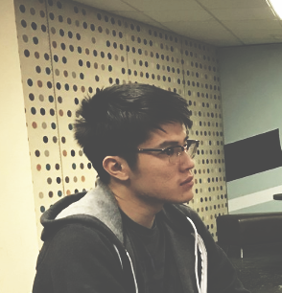
Ryan He
zhe66@gatech.edu

Slide 8
Daniel Kane
dkane6@gatech.edu

Slide 9

Austin Passmore
lpassmore3@gatech.edu

Slide 10

Isabelle Steffens
isteffens3@gatech.edu

Slide 11

Ethan Wilson
ewilson72@gatech.edu

Slide 12
Ray Tracing: Global Illumination & Rendering
Turner Whitted. 1980. An improved illumination model for shaded display. Commun. ACM 23, 6 (June 1980), 343-349. DOI=10.1145/358876.358882 http://doi.acm.org/10.1145/358876.358882

Slide 13
Intuitive, Simple to Understand

Slide 14
Basis of Modern Global Illumination
Images from https://en.wikipedia.org/wiki/Ray_tracing_(graphics)

Slide 15
Basis of Animated Film
Pixar’s Renderman, recently Disney’s Hyperion
http://www.fxguide.com/featured/disneys-new-production-renderer-hyperion-yes-disney/
http://www.engadget.com/2014/10/18/disney-big-hero-6/
http://www.geek.com/chips/inside-the-199-million-core-hours-that-created-big-hero-6-1609488/
Big Hero 6
Videos (Sizzle Trailer https://www.youtube.com/watch?t=39&v=ckAGKzTKsvw, Graphics Tech https://www.youtube.com/watch?v=w4WD15EgLWc)
Hyperion renders 10 – 20 bounces of indirect lighting
Create new render farm: 55,000-cores across four geographic locations
San Fransokyo contains around 83,000 buildings, 260,000 trees, 215,000 streetlights and 100,000 vehicles (plus thousands of crowd extras)
20 million microbots onscreen in a given shot, on average
199 million core-hours to render
Peak production ran at 1.1 million core-hours per day
Tangled was 11.5 core-hours, could render on the BH6 farm in under 10 days

Slide 16
Online (“real-time”) Rendering Inverts Things
http://techpubs.sgi.com/library/dynaweb_docs/0630/SGI_Developer/books/Perf_PG/sgi_html/ch02.html

Slide 17
GPUs let us blur the lines
http://madebyevan.com/webgl-path-tracing/
http://docs.unity3d.com/Manual/GIIntro.html

Slide 18


Slide 19
Overview of the Class
First 10 weeks: Global Illumination (offline) vs Interactive Graphics (online)
Interactive 3D graphics
3D mathematical foundations
Scene graphs, the graphics pipeline
Shading and lighting
Hardware and GPU programming
Intro to Global Illumination with Ray tracing
Return to other topics later
Curves, surfaces, meshes, data structures and models
More rendering (Radiometry, Light and Color)
Real time interactive graphics

Slide 20
Administrivia

Slide 21
Topics
From the catalog
Geometric constructions; transformations; perception; reflection models; photorealistic; non-photorealistic, and image-based rendering; rendering software and API's; triangle-mesh processing; graphic acceleration; user-interaction, design and animation.
Essentially
Modern 3D graphics, both online and offline
Creating interactive graphical applications

Slide 22
Prerequisites
MATH 2605 or MATH 2401 or MATH 2411 or MATH 24X1, and
Calc III: Linear algebra, calculus concepts, numerical methods
Why? Graphics uses math, especially these topics
CS 2110 or CS 2261, and
Hardware/software systems, how machines work
Why? Understanding graphics hardware, GPU programming
CS 1332, and
Data structures and algorithms
Why? Trees, lists, queues, more complex spatial data structures
CS 2340
OOP, software design, debugging and testing
Why? Graphics programs and libraries are complex, we’ll use objects and OOP

Slide 23
Learning Objectives
Understand
Mathematical and algorithmic foundations of computer graphics
Limits of approximating real visual phenomena digitally
Differences between online and offline graphics techniques
Modern graphics hardware architectures, GPU programming
How to create interactive graphical applications
Additionally
Tools, technologies and techniques for doing interactive 3D graphics on the web

Slide 24
Class Resources on github.com
http://github.com/cs3451
Source to everything (website, samples, assignment source code)
Website will change over semester
I’ll try to make the changes obvious! Will post announcements to the site
Schedule is a starting point, may also change
But I’ll try not to move assignment deadlines and midterm date

Slide 25
Grading
Heavy emphasis on assignments
Assignments: 75%
Assignment 0: 5%, remaining 5 share 70%
Midterm exam: 10%
Final exam: 15%
Final Grade:
60 70 80 90
F | D | C | B | A

Slide 26
Lectures
Read the material
Bring a laptop
You are responsible for anything we talk about in class. If you miss class, talk to classmates!

Slide 27
Annoying Warning
I’ve had too many complaints about students distracting others by goofing around on laptops. So: NO OPEN LAPTOPS in class, unless we ask you to take them out
If you like to take notes on your laptop, fine. But, I may ask you to show me what you are doing, at any moment. And I may ask you to send me your notes, just to see.
No recording devices, without permission
If you want to use a Livescribe, audio recorder, etc., let me know
You may NOT record any video
You MUST NOT share ANY recording (pics, audio) with anyone outside the class

Slide 28
Questions?

Slide 30
Next class
Interactive walkthrough of some web programming, Typescript and Javascript concepts

Slide 31
Setting up for Development
Ensure you have a browser that supports WebGL and web debugging
Any up-to-date browser should work
Install Git
https://mac.github.com or https://windows.github.com
Log into github.com, create an account if you don’t have one, doesn’t need to be personally identifying (we’ll get you to submit it)
Install Node (including npm and other tools)
http://nodejs.org
Install Typescript
http://www.typescriptlang.org/#Download
npm install –g typescript

Slide 32
Install an editor with Typescript language service extension
I’m currently using Visual Studio Code
https://code.visualstudio.com
Also: Visual Studio, WebStorm, Atom, Sublime Text, Eclipse all have some level of support
Check out the Typescript samples
https://github.com/Microsoft/TypeScriptSamples
Clone ex1 from class repository
https://github.com/cs3451/f19-ex1

